Slide 1
Finding the Best Town in Derbyshire for a Coffee Shop

Slide 2
Data Acquisition
To solve this problem the following data will be required:
Demographics and population data of the towns
Salary data for each town
Location data of existing coffee shops within the towns to determine which areas of the town would have the least competitors.
The data will be sourced from the office of national statistics and Foursquare location data.

Slide 3

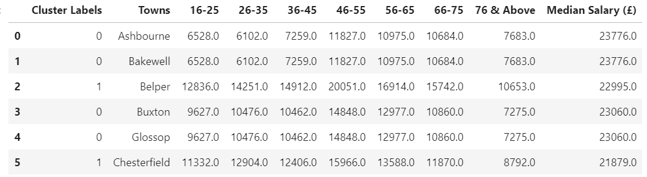



Data used in Dataframe Format

Slide 4

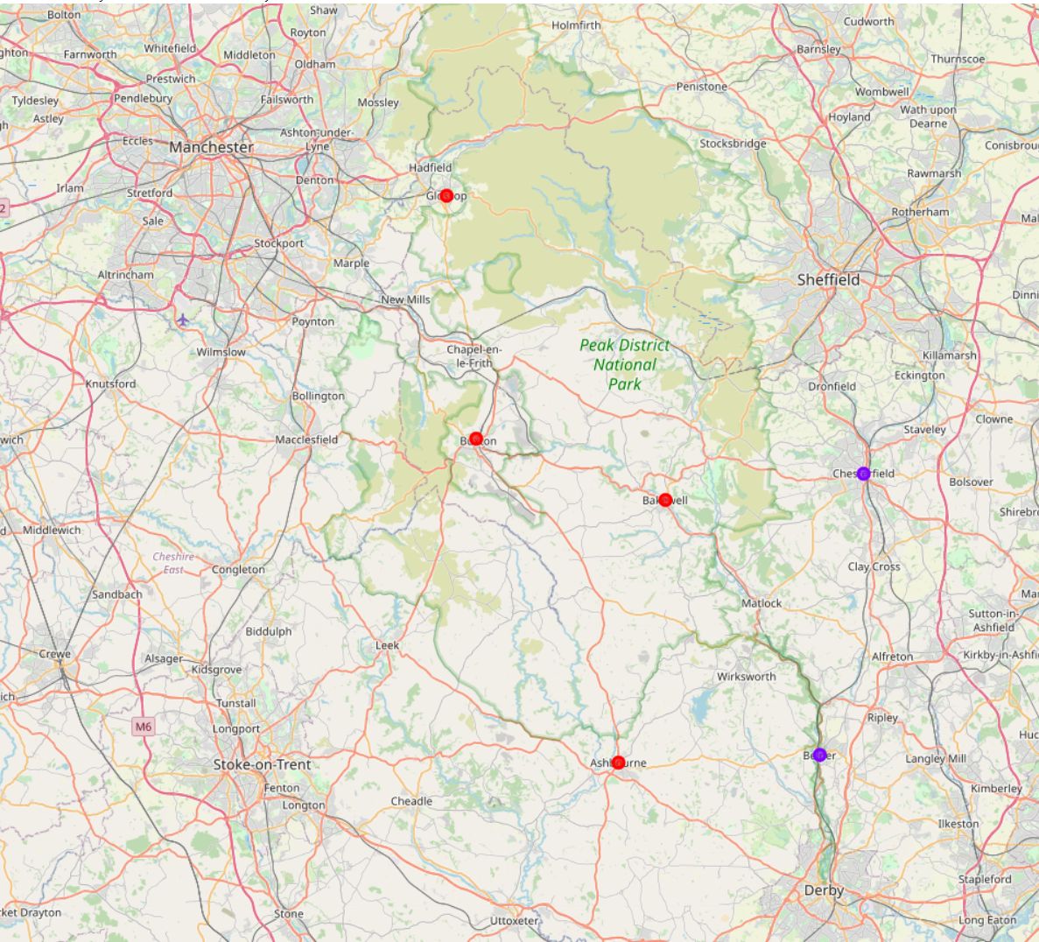
Map showing the potential towns for the coffee shop
K-means clustering used to separate the towns into two clusters
Clusters represented by purple dots have younger demographics

Slide 5
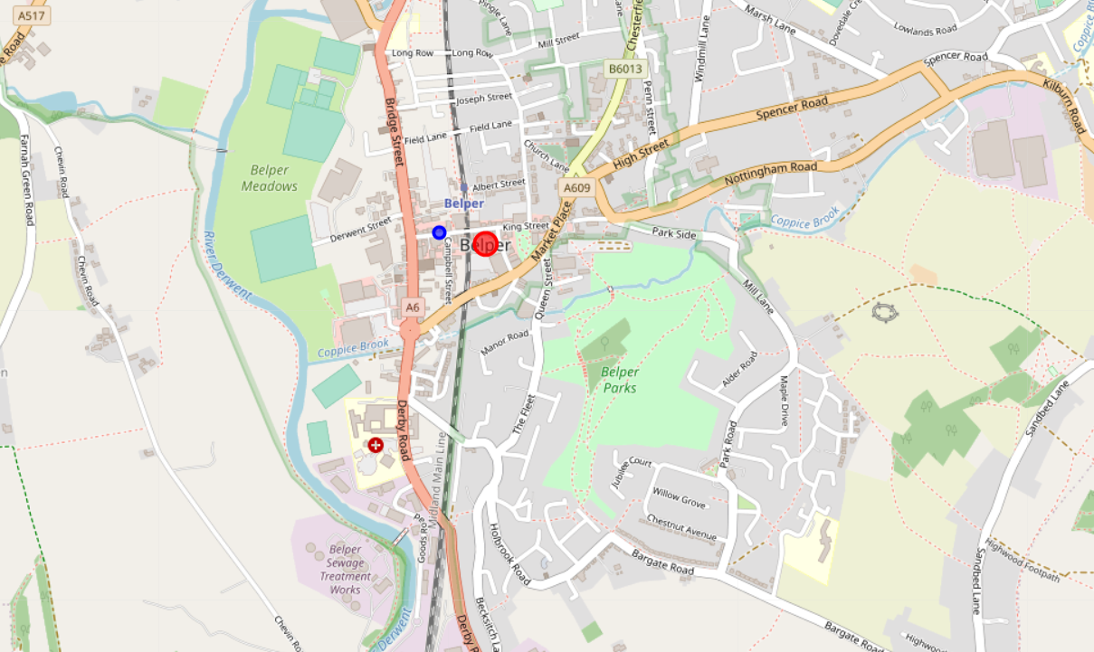
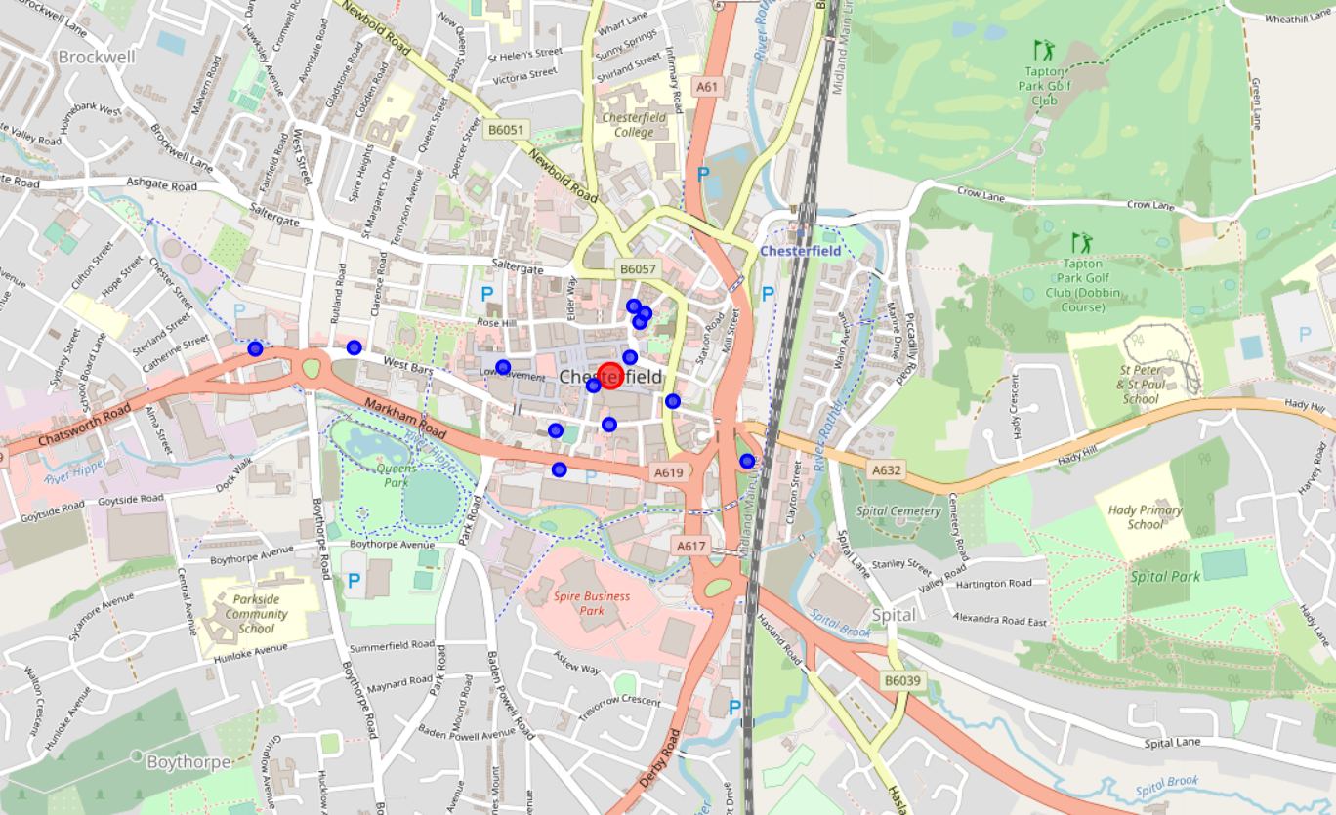
Coffee Shops in Belper and Chesterfield
Belper has far fewer coffee shops than chesterfield and so offers less competition.

Slide 6
Conclusion
In this piece of work Belper has been identified as the most suitable town in Derbyshire to set up a new coffee shop. Demographic and salary data have been used to determine a towns suitability for the new coffee shop. K-means clustering was used to segment the towns into two clusters. The towns in the cluster that displayed the characteristics that were initially identified as favourable were further investigated to determine the amount of competition in these towns. The town with the least completion was chosen as the town to set up the coffee shop. This town was Belper.
Further work should be conducted before confirming to start a coffee shop at Belper this should include but not be limited to: identify the area of Belper most suitable for the new shop data such as the number of people who walk past on the street and risk of flooding or other natural disasters should be investigated. Also, it is still important that the town be inspected in person to identify any opportunities or challenges that may be present that the data has not identified.

